Slide 1
BURAK KELES HOSPITAL GUIDE PROJECT
hospital-guides.com

Slide 2
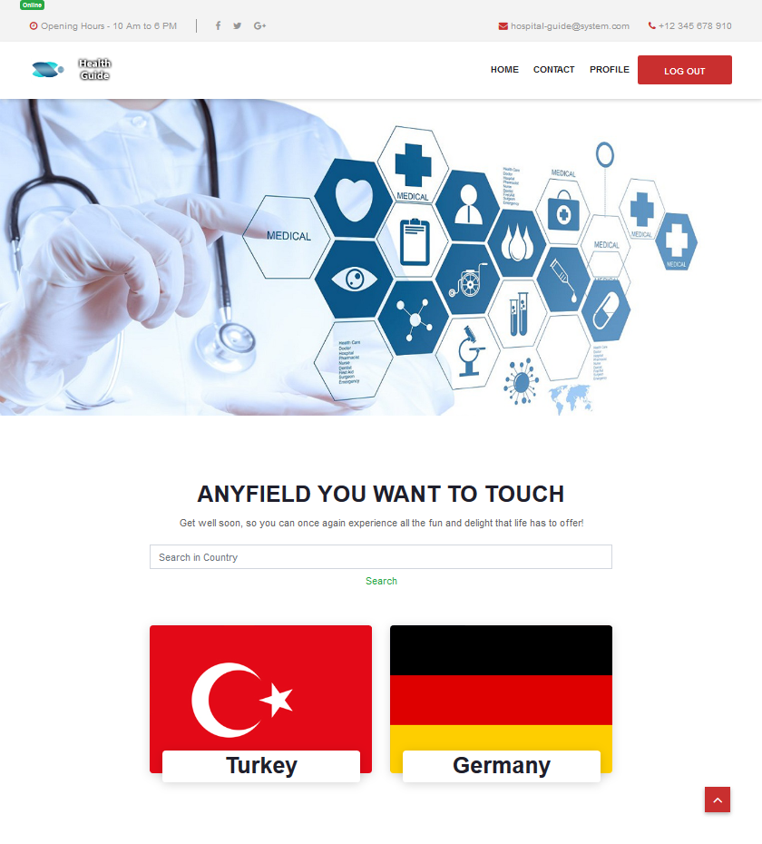
This is the homepage of website. When the users enters the direct link they access to that page. Main scenario starts from here. Users can Access to Login Register Contact fields directly see countries on system.

Slide 3
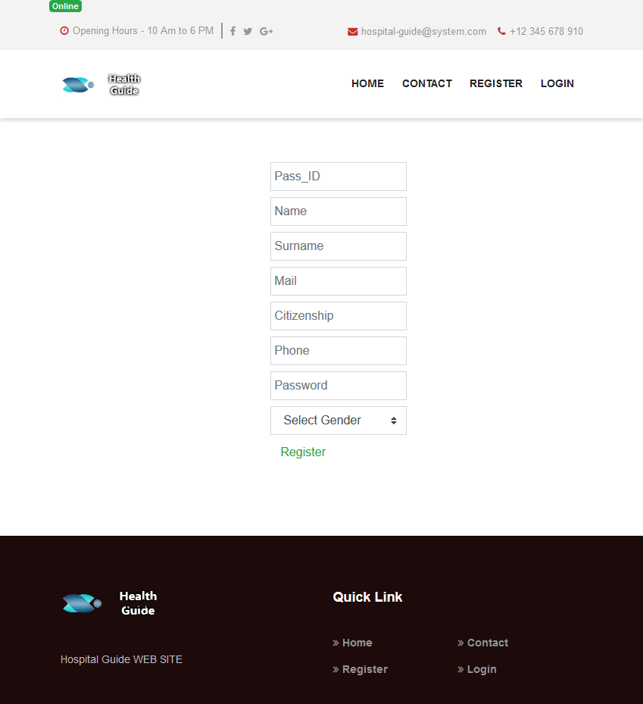
Registerpage allows users to create an account to use the website fully.

Slide 4
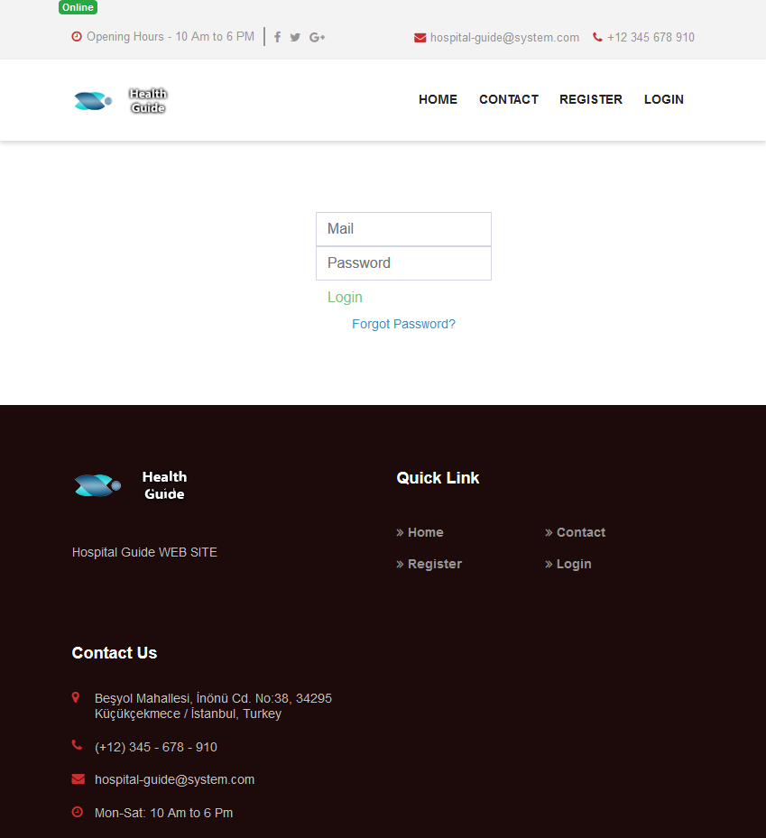
In loginpage users enter their mail address and password that used while creating an account.

Slide 5
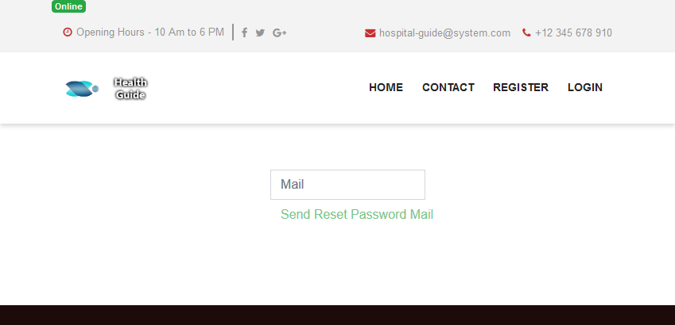
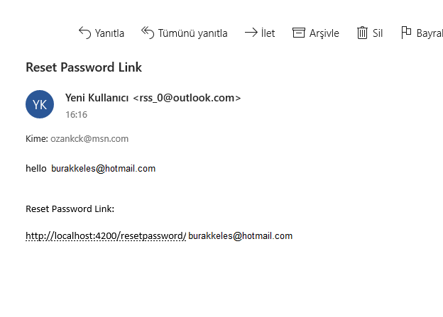
In this page users enter their mail address used in register section. And click to Send reset password mail button. After that application generate an email for that user and sends it to users’ mail adress. By using the link in the mail users can reset their password.

Slide 6
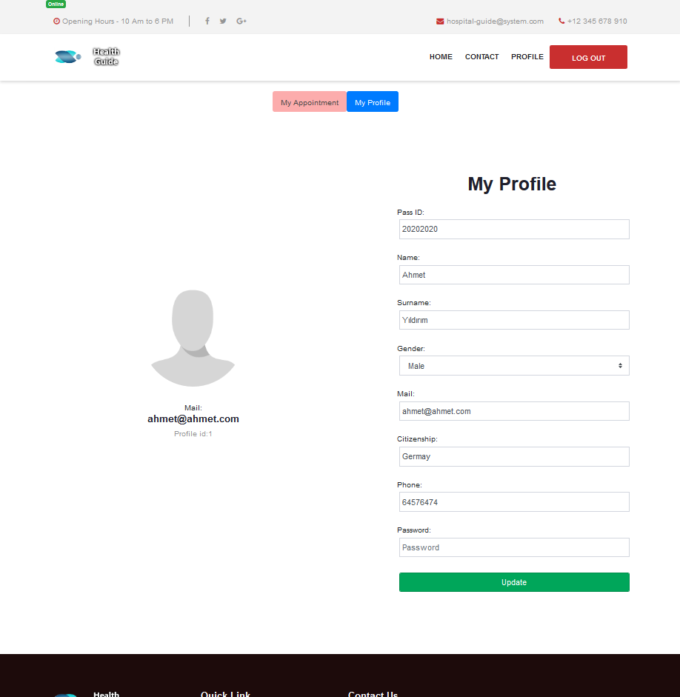
In this page users able to see their account information. If they want to change any information click to related field and enter new data to field and click update.

Slide 7
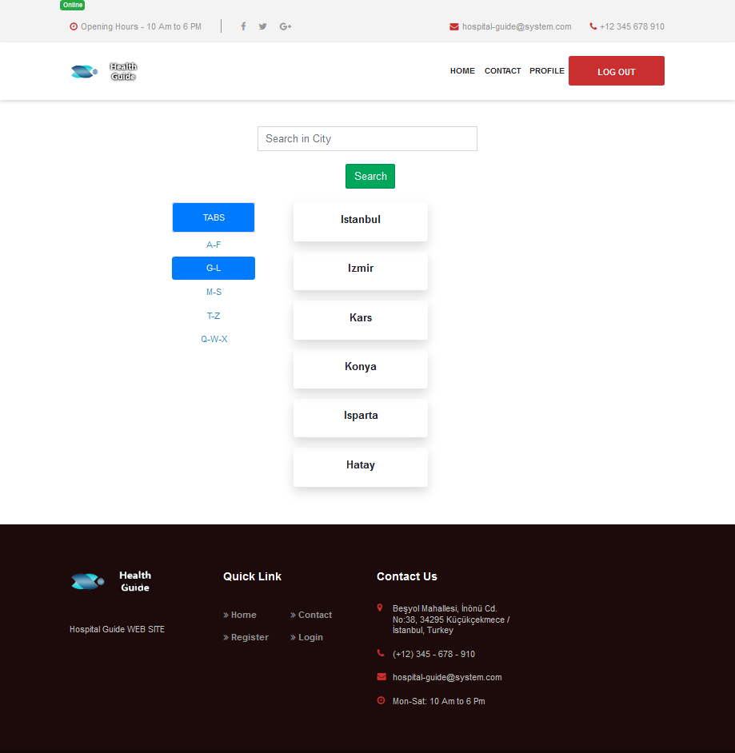
After users select the country they become able to select city.In citiespage There are 5 tabs that helps user to categories cities by their name

Slide 8
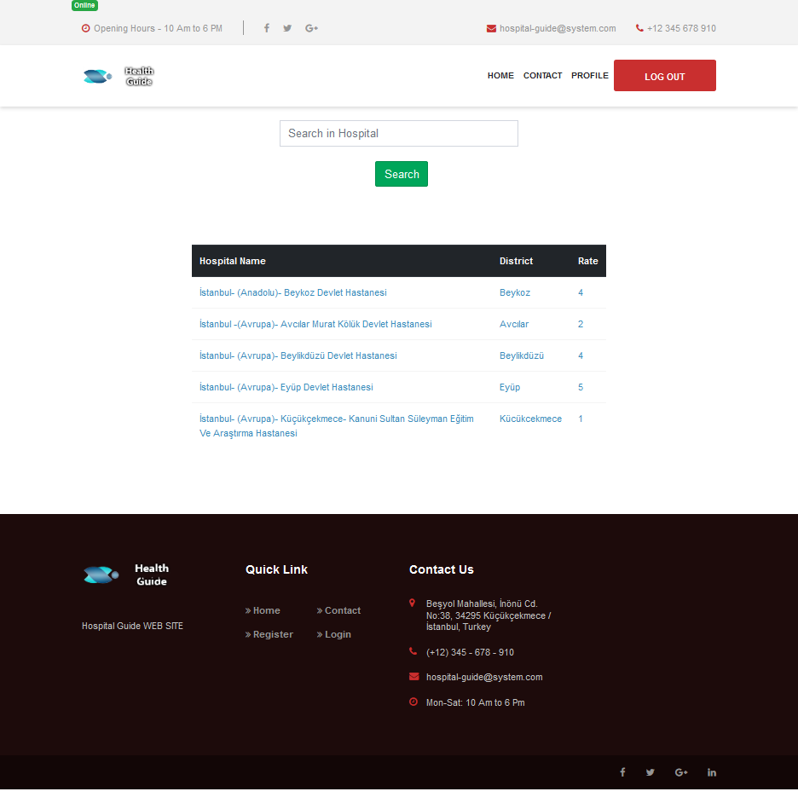
After select city. Hospitalspage loads hospitals in that city. Users see the Hospital name, Its District and Rate information.

Slide 9
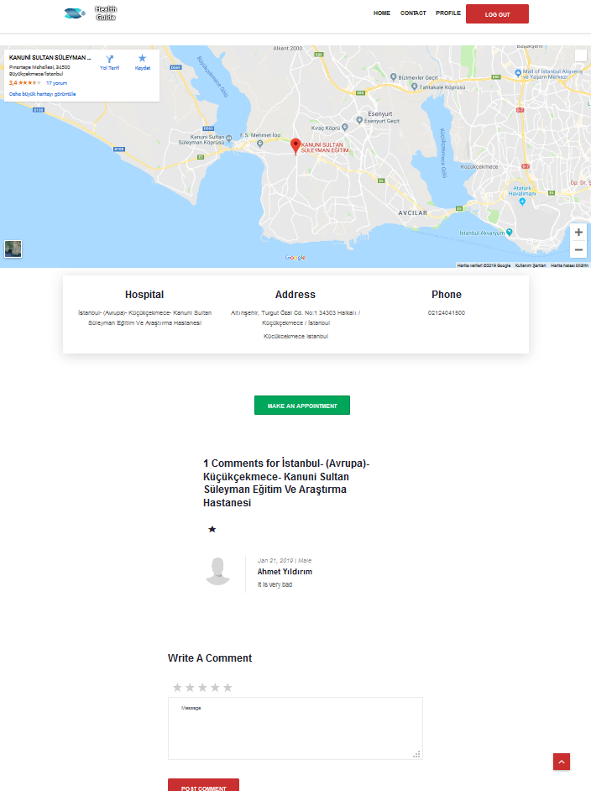
After select hospital from hospitalpage. Hospitaldetailpage load detailed information of related hospital and user can see.
They can make comment and rate if they wan to do or just click make an appointment button and create an appointment.

Slide 10
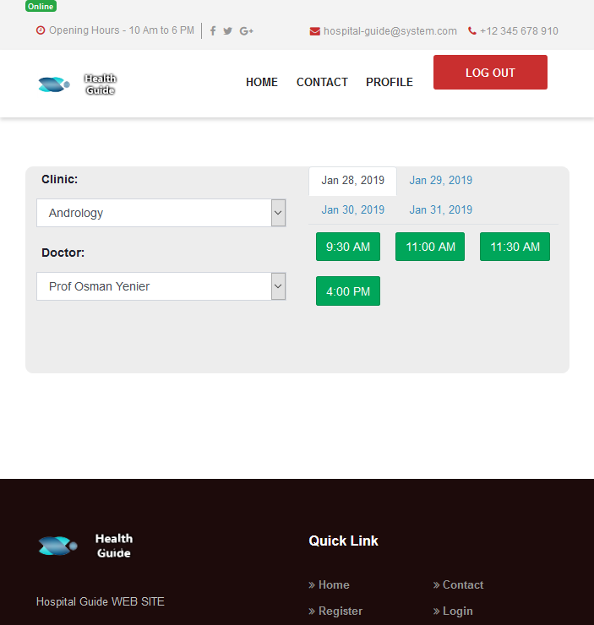
After user click to book an appointment application loads appointmentpage and users select their clinic, doctor, day and time informations from related fields.

Slide 11
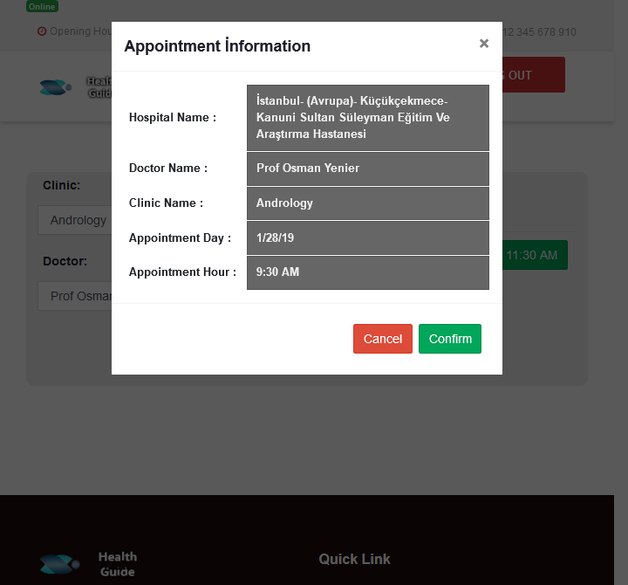
After select the appointment time application generates a pop-up screen and users see all the information of the appointmet.

Slide 12
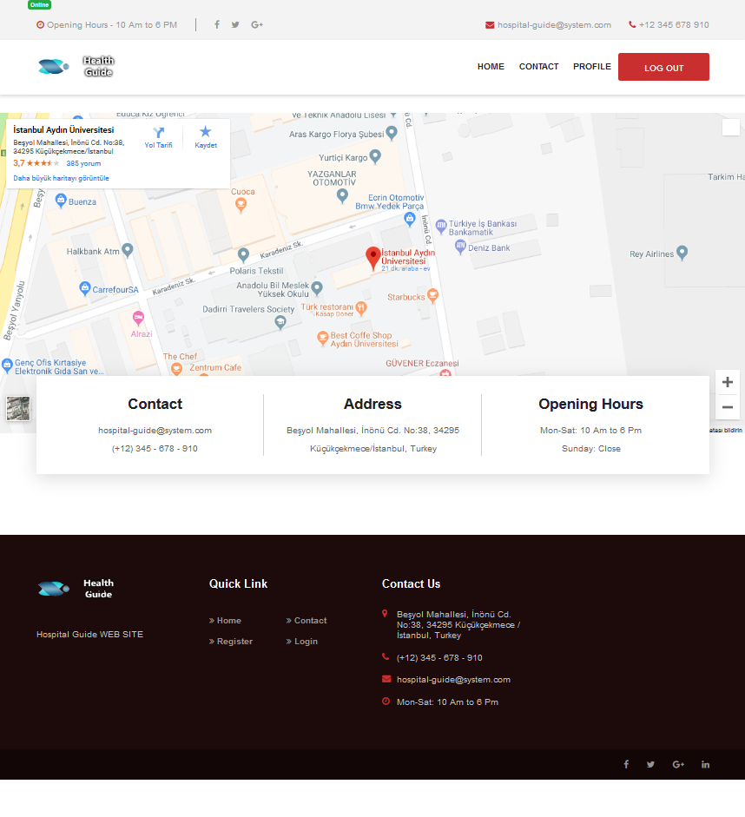
Contact page of website.
Contact information are listed in this page.

Slide 13
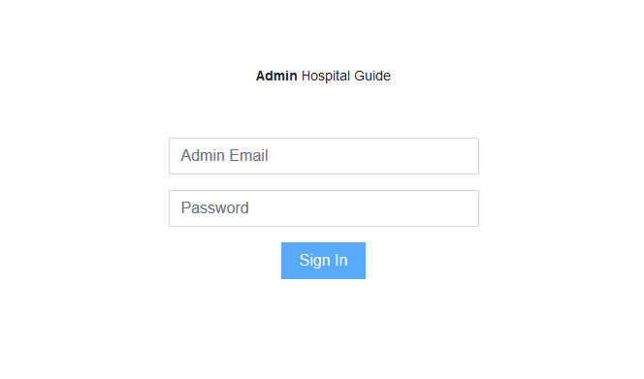
Admin login process done by that adminloginpage.

Slide 14
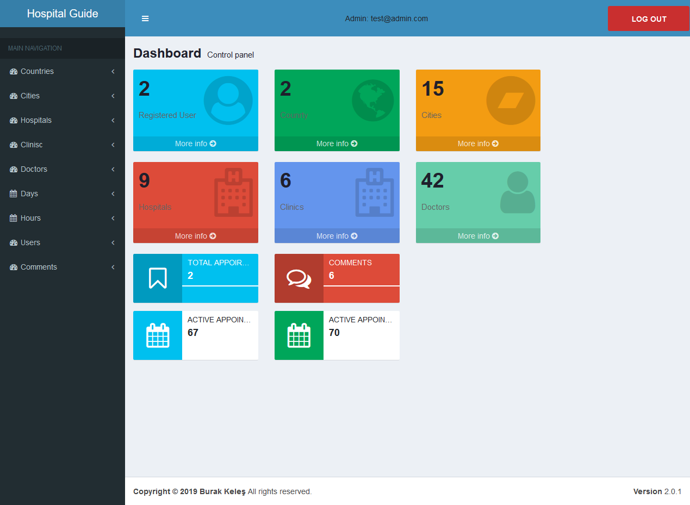

Slide 15
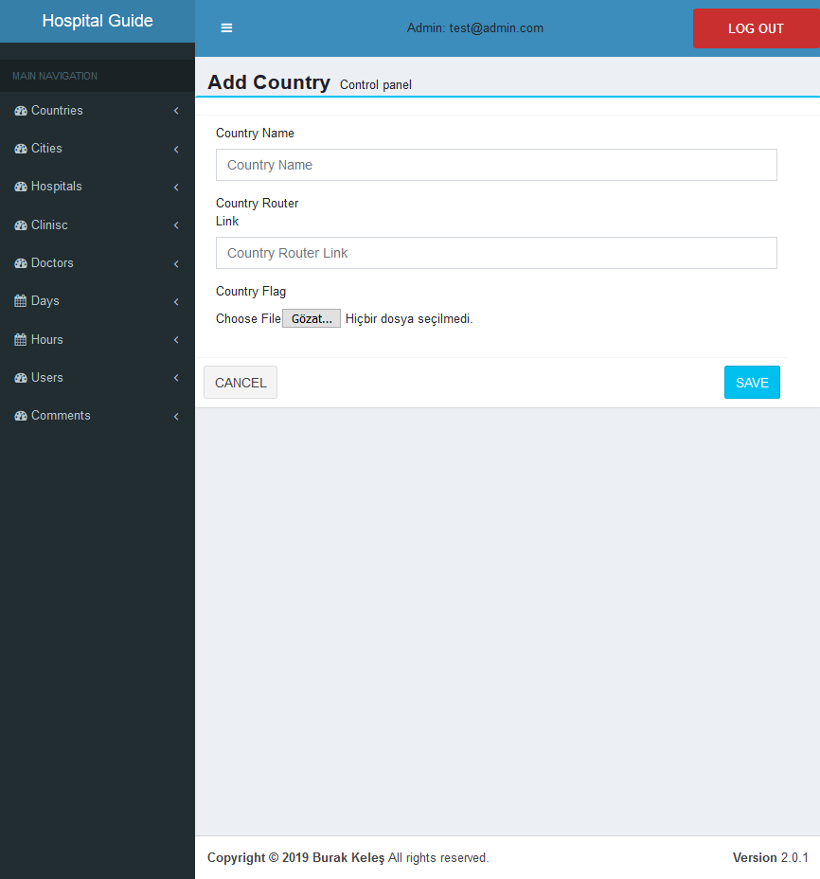
Admin selects the add country process from main navigation and website load related page.
By filling all the fields admin add a country to system.

Slide 16
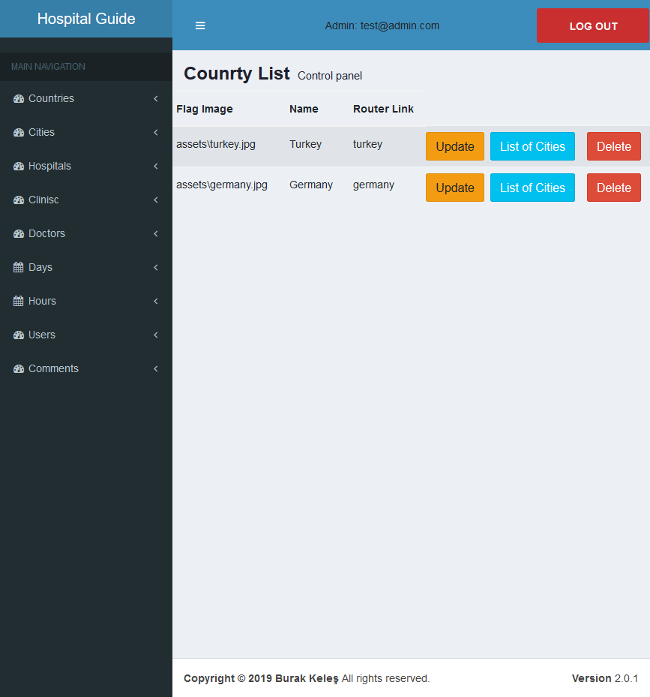
Added countries are listed in countrylist section. Admin can update country, delete country or list the cities of related country.

Slide 17

This is the page for the update information of country.

Slide 18
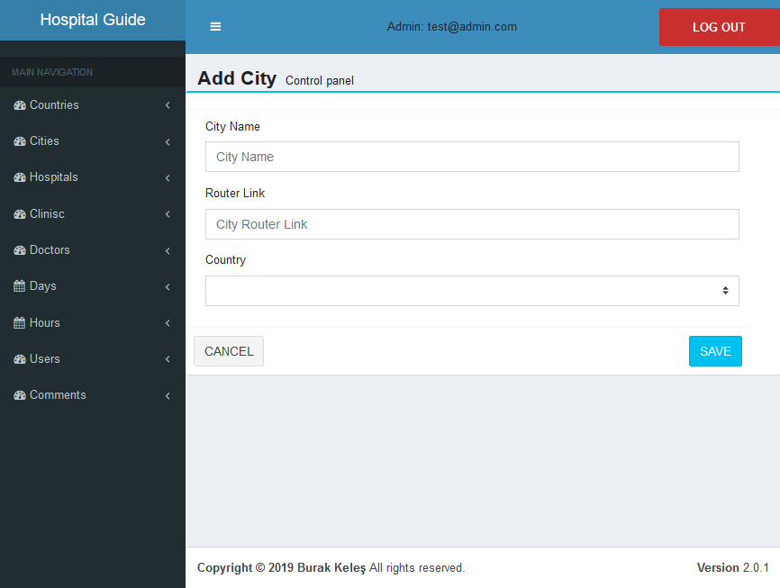
Admin can add city to a country by select add city process by main navigation and application loads related component. Admin enters information to related fields and save it.

Slide 19
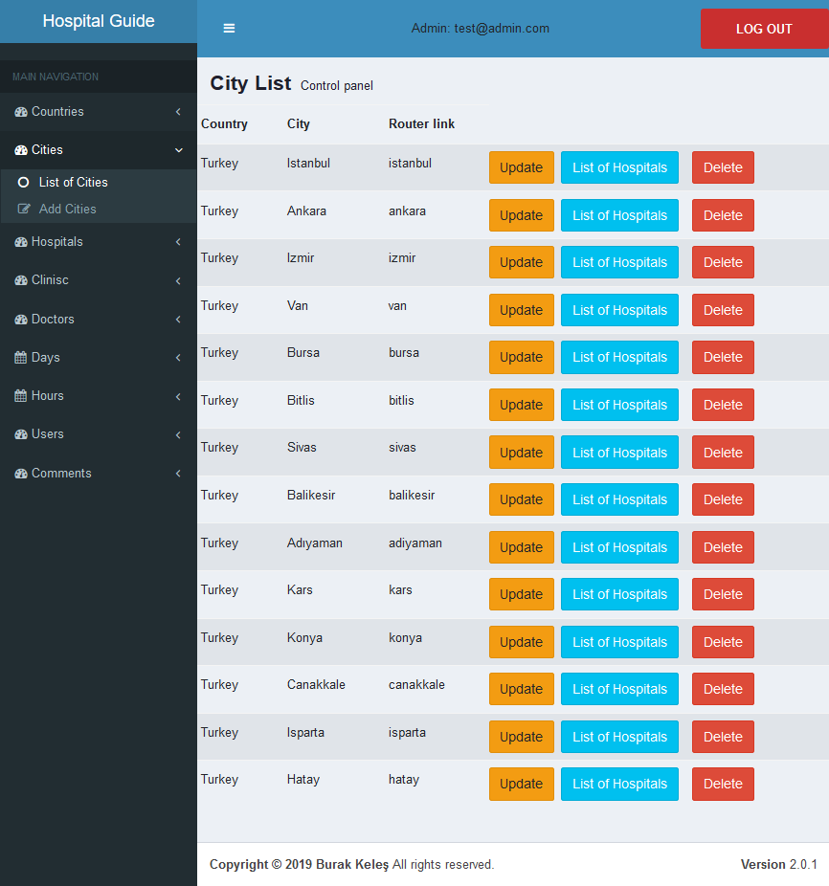
Added cities are listed in citylist section. Admin can update city, delete city or list the hospitals of related city.

Slide 20
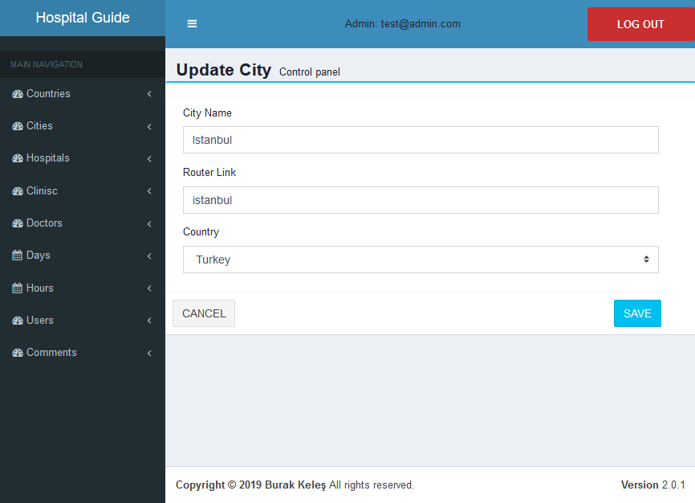
This is the page for the update information of city.

Slide 21
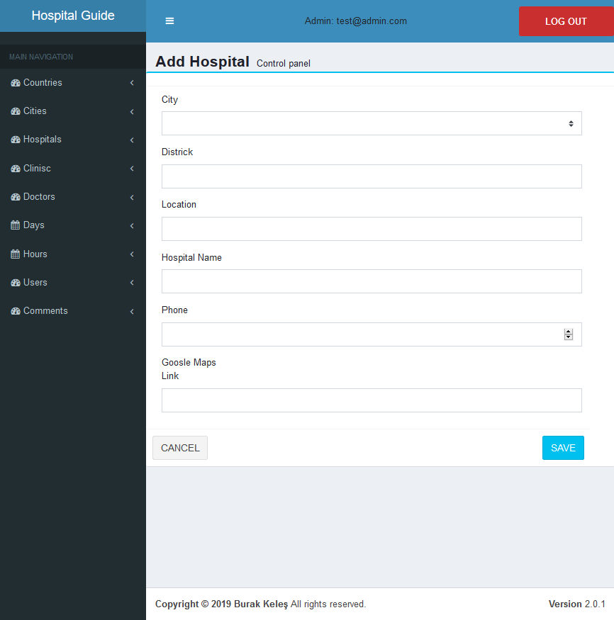
Admin can add hospital to a city. First select add hospital process from main navigation and then fills the fields.

Slide 22
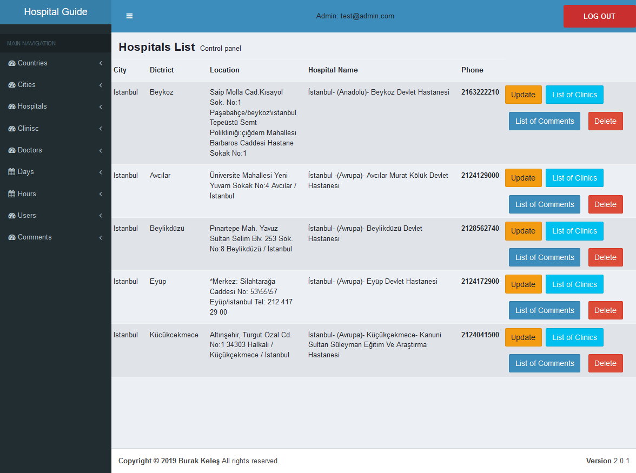
Added hospitals are listed in citylist section. Admin can update hospital, delete hospital or list the clinics of related hospital.

Slide 23
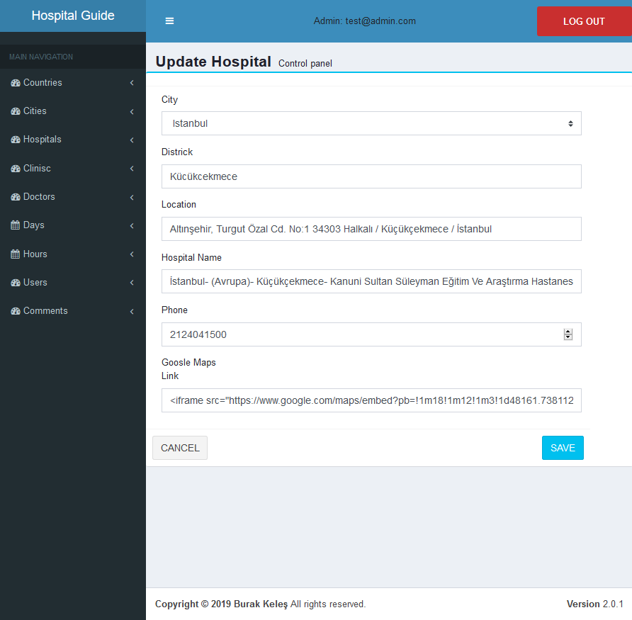
This is the page for the update information of hospital.

Slide 24
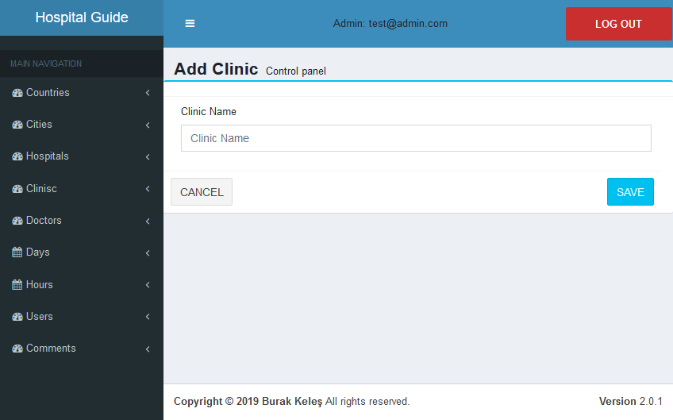
Admin can add a clinic system. First select add clinic process from main navigation and then fills the related fields. After save the clinic clinic can be use for add doctor.

Slide 25
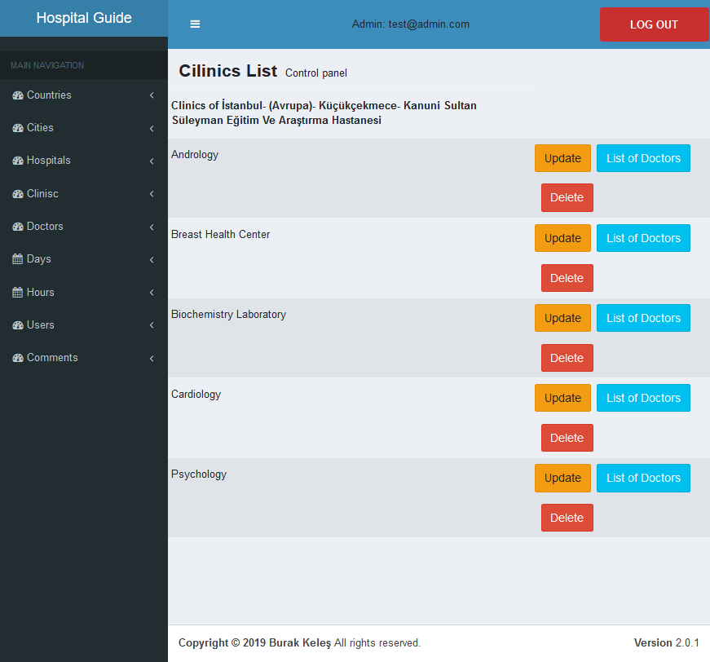
Added clinics are listed in cliniclist section. Admin can update clinic, delete clinic or list the doctors of related clinic.

Slide 26
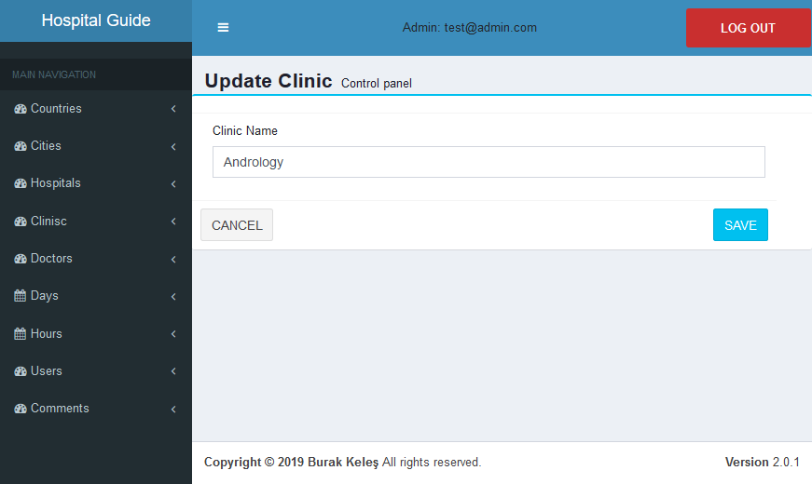
This is the page for the update information of clinic.

Slide 27
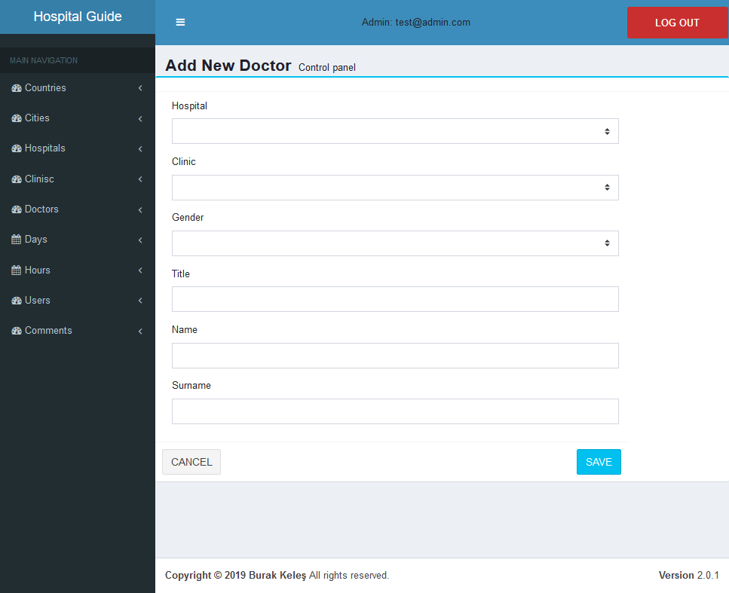
Admin add doctor to system on adddoctorpage. Process started by select the add doctor from main navigation. After admin save the doctor. Schedule of doctor can be create

Slide 28
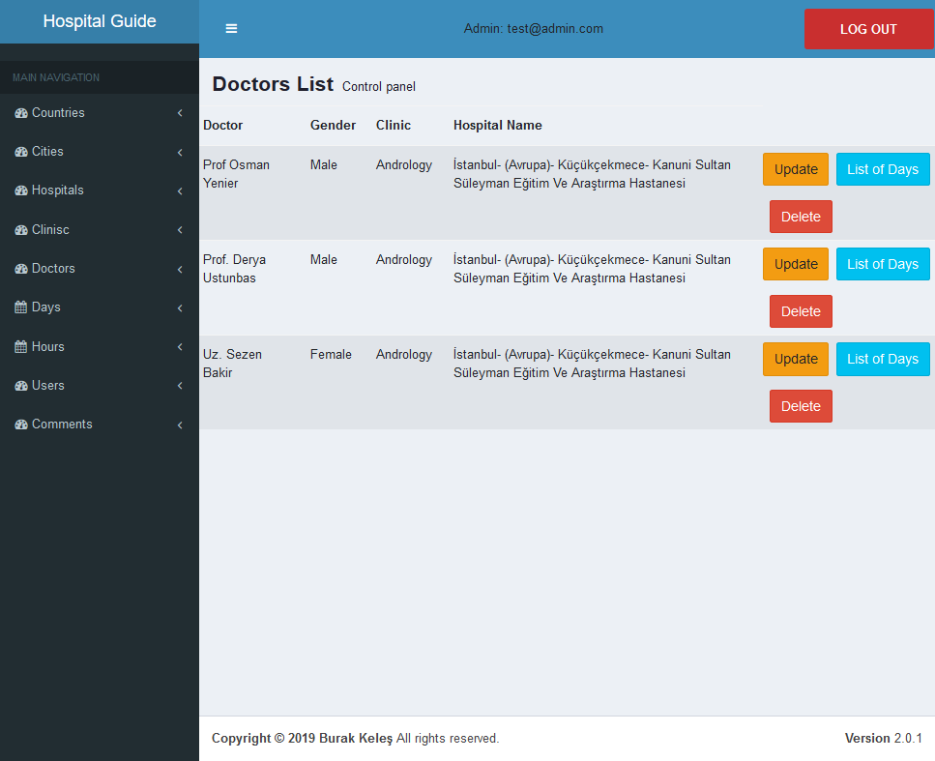
Added doctors are listed in doctorlist section. Admin can update doctor, delete doctor or list the days of related doctor.

Slide 29
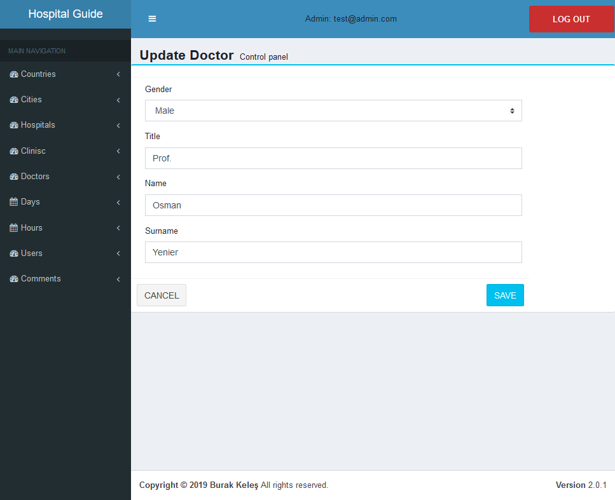
This is the page for the update information of doctor.

Slide 30
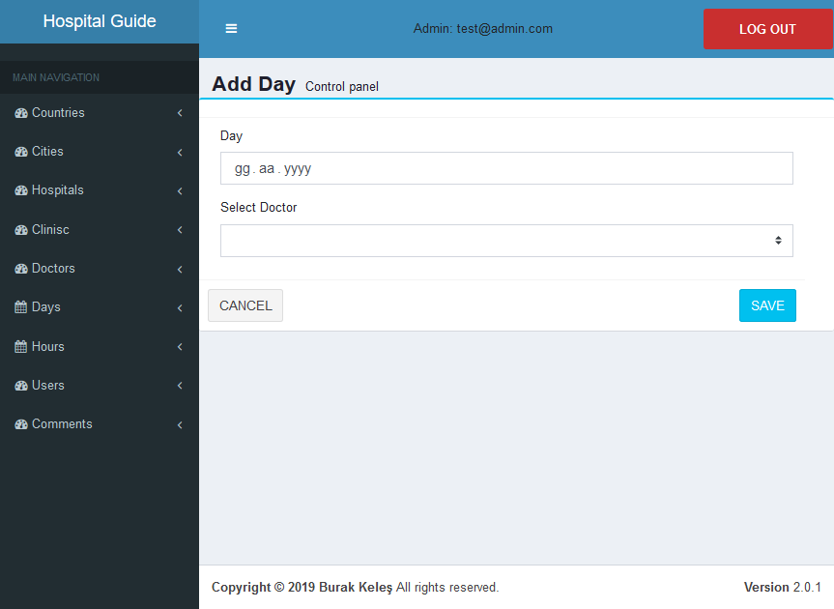
Admin creates doctors Schedule day by select add day from main navigation. After page load selected day is assigned to doctor.

Slide 31
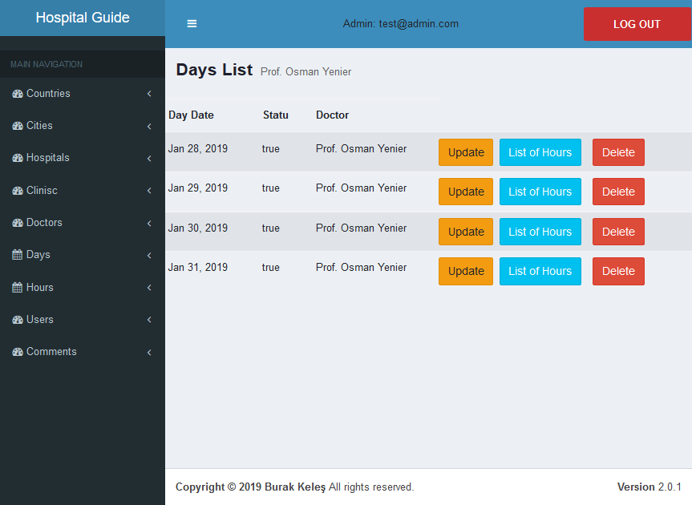
Added days are listed in daylist section. Admin can update day, delete day or list the hours of related day.

Slide 32
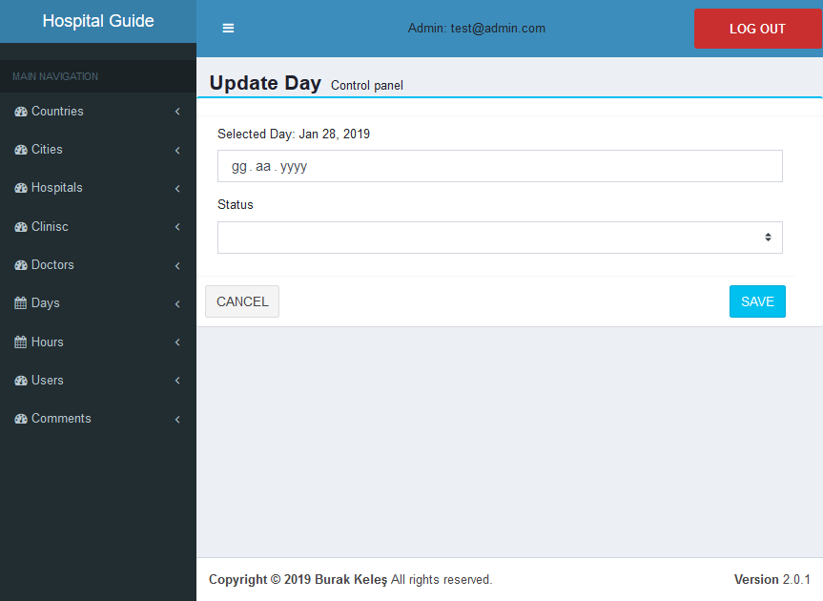
This is the page for the update information of day.

Slide 33

Admin can add hour to a doctors work Schedule. Add hour process selected from main navigation and addhourpage loaded. Admin Assign a work hour to a doctor with day.

Slide 34
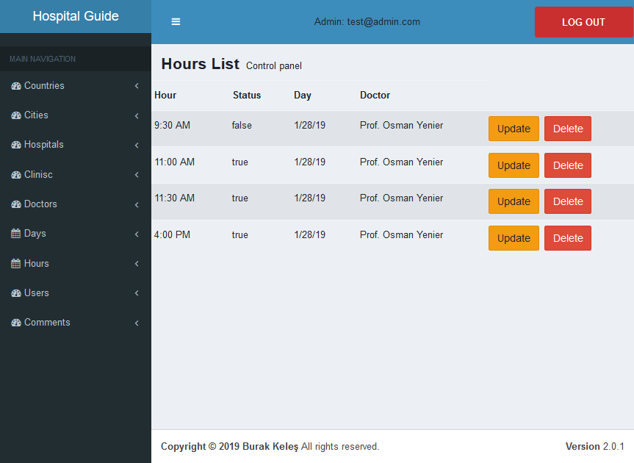
Added hours are listed in hourlist section. Admin can update hour or delete hour.

Slide 35

This is the page for the update information of hour.

Slide 36
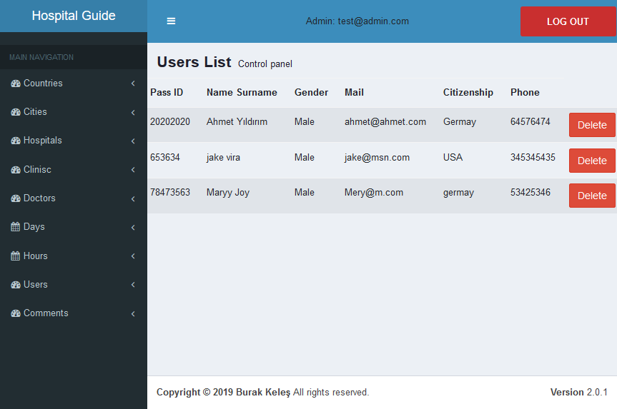
Admin see the userlist by select users from main navigation. In this page admin can delete a user.

Slide 37
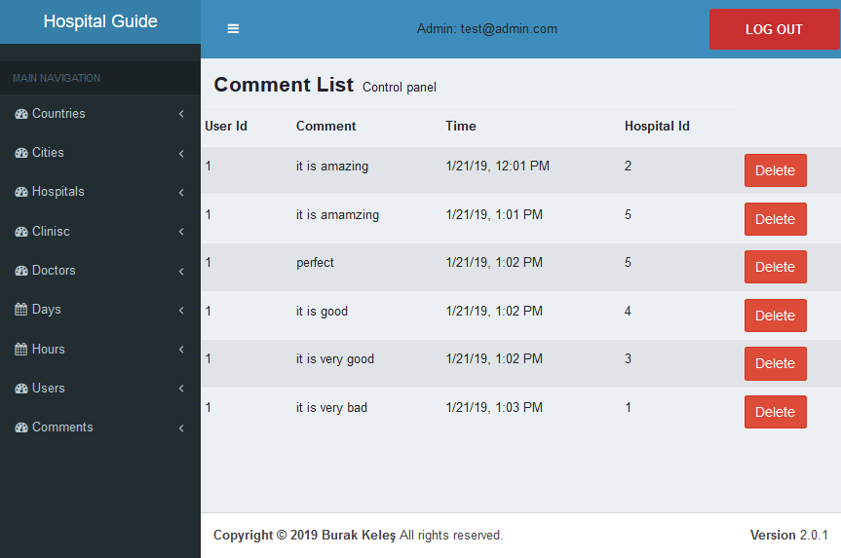
Admin can list comments by select commnets from main navigation. On that page admin can delete a comment that made for a hospital.

Slide 38
THANK YOU

